Slide 1

DATA SCIENCE PROJECT ON WIND & SOLAR

Slide 2

Business Problem Statement
GreenGrid Power Solutions has access to extensive historical energy data from its distributed renewable assets. However, the organization lacks predictive capabilities and an interactive interface that enables decision-makers to explore trends and plan effectively.
Currently, static reports and the absence of forecasting tools hinder timely planning, optimal resource utilization, and effective communication of clean energy performance—especially in response to fluctuating weather conditions. This limits GreenGrid’s ability to make data-driven operational decisions in a rapidly evolving energy landscape.

Slide 3
1. Problem Understanding
Identify the business need: improve forecasting and interactive reporting for renewable energy generation.
Define the objective: forecast daily energy generation for the next 30 days and build a dashboard.
2. Data Collection
Gather historical data on:
Energy generation (MWh)
Weather conditions (temperature, wind speed, cloud cover)
Temporal context (day type, season)
Ensure data covers multiple sites and both energy types (solar, wind).

Slide 4
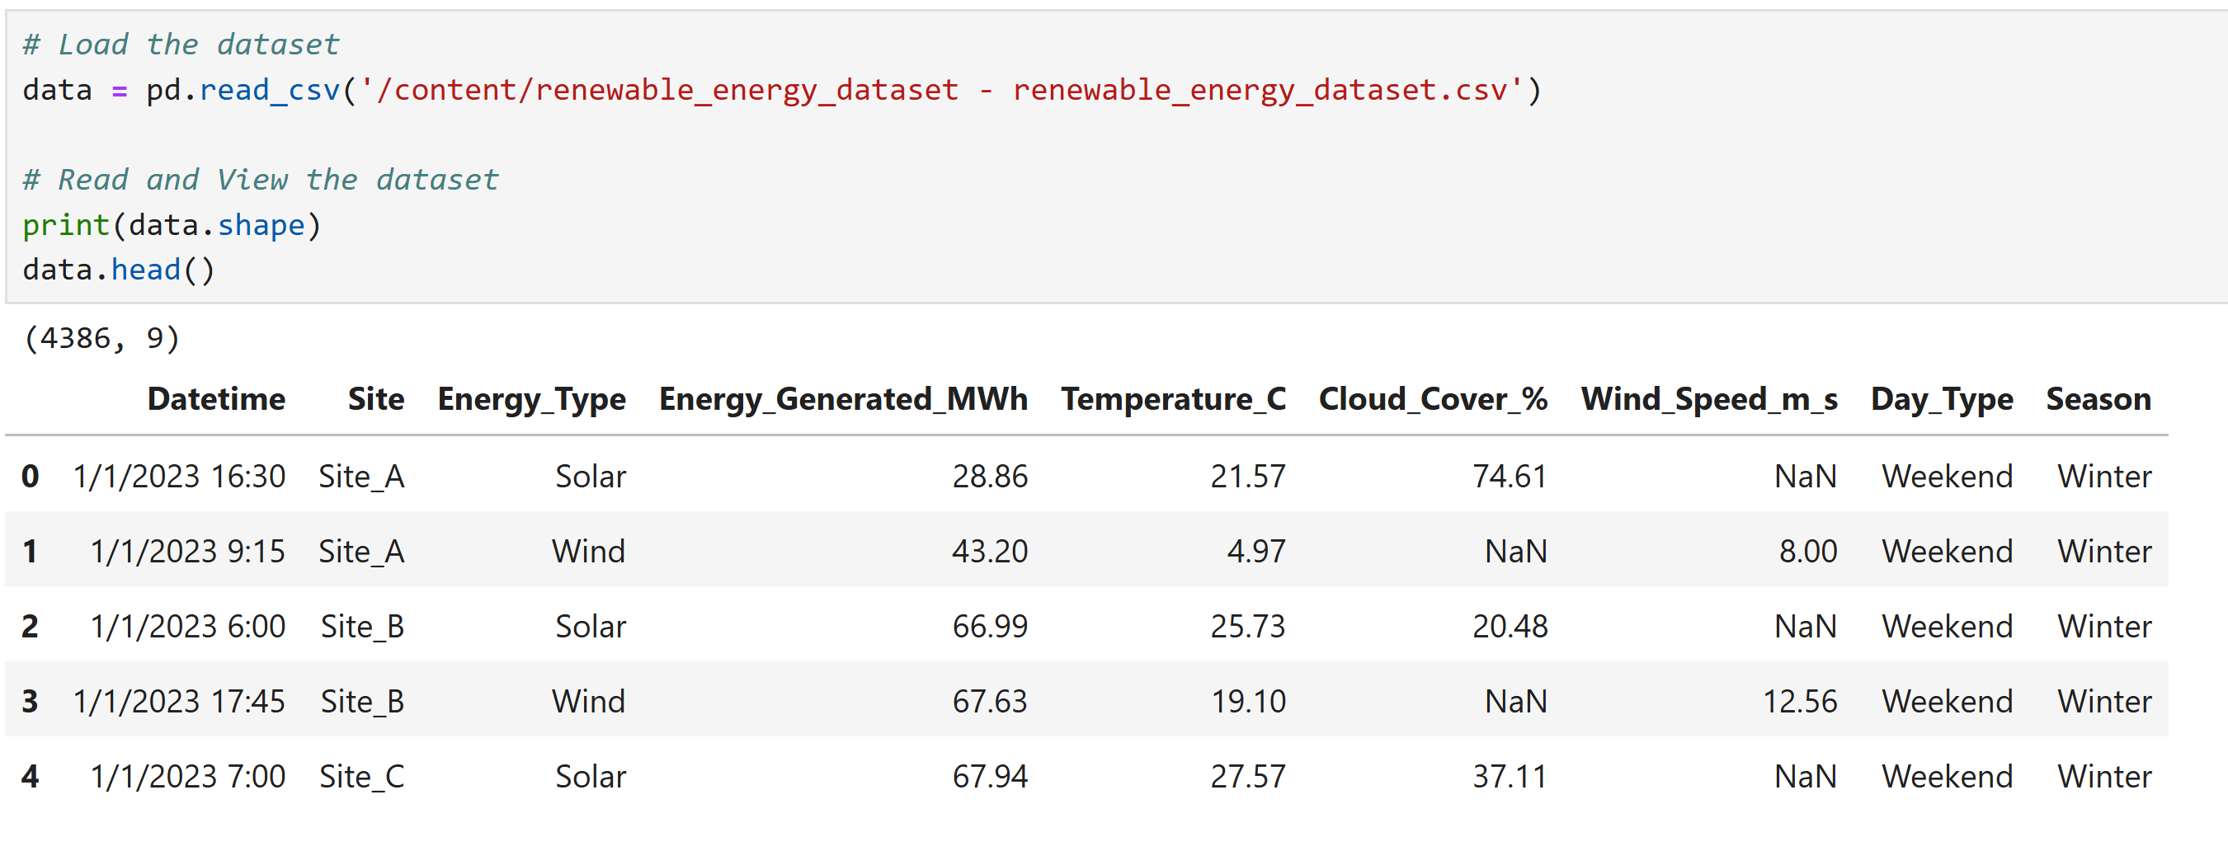
3 Data Ingestion & Preprocessing
Load and combine datasets using Jupyter Notebook.

Slide 5
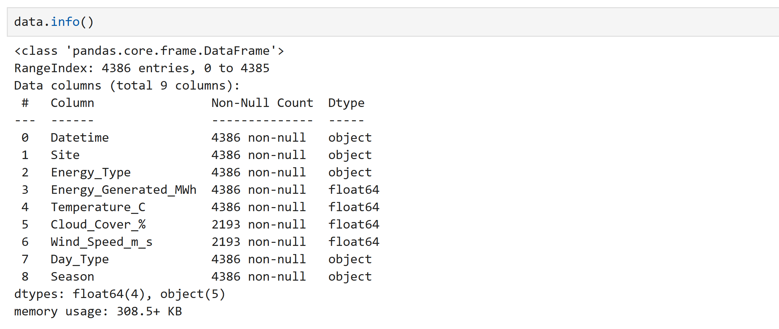
Data types

Slide 6
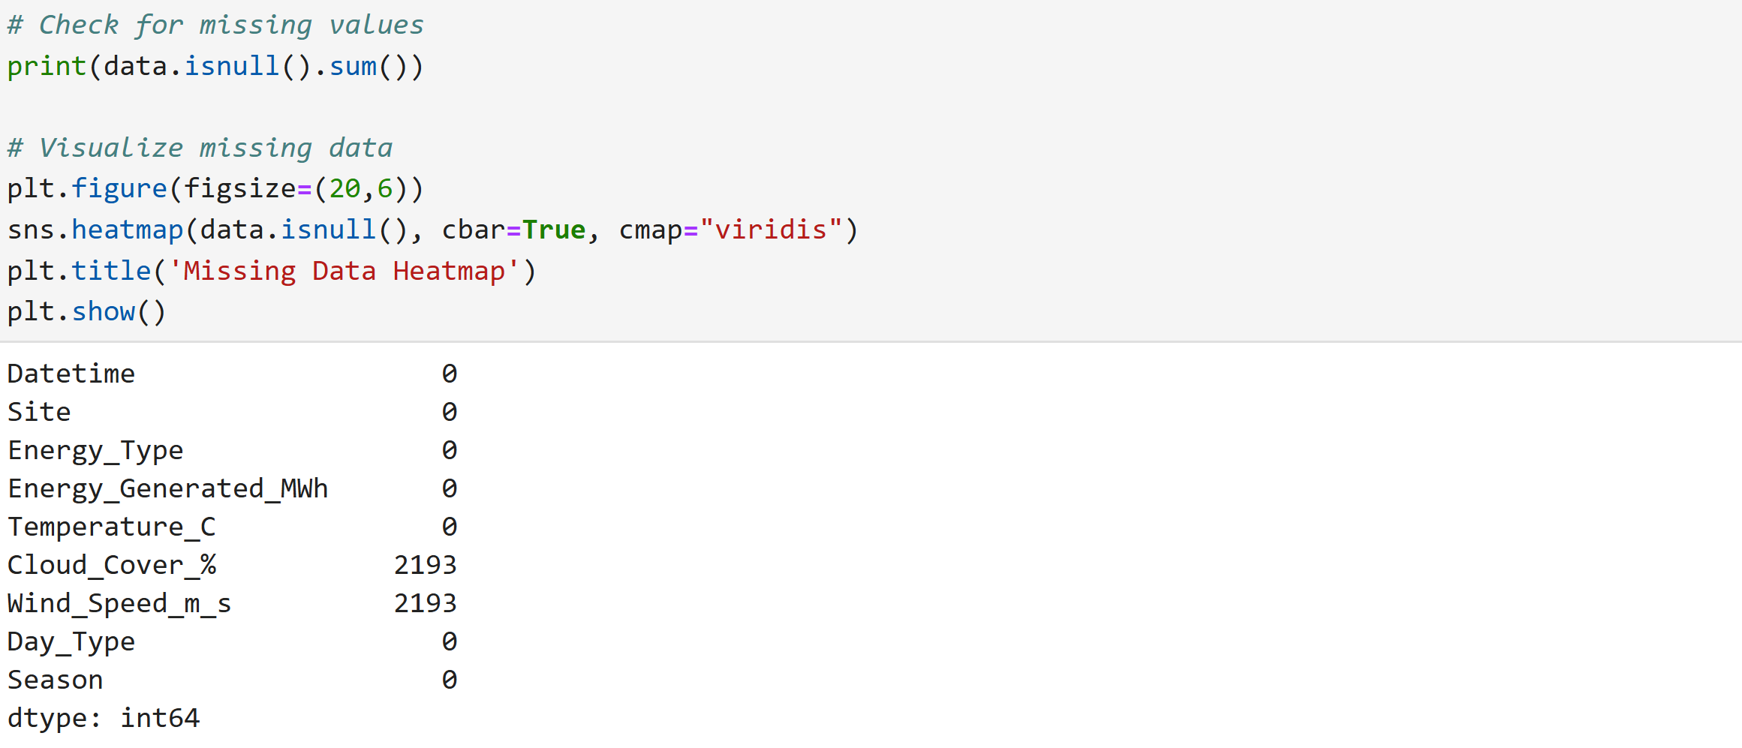
Missing values

Slide 7
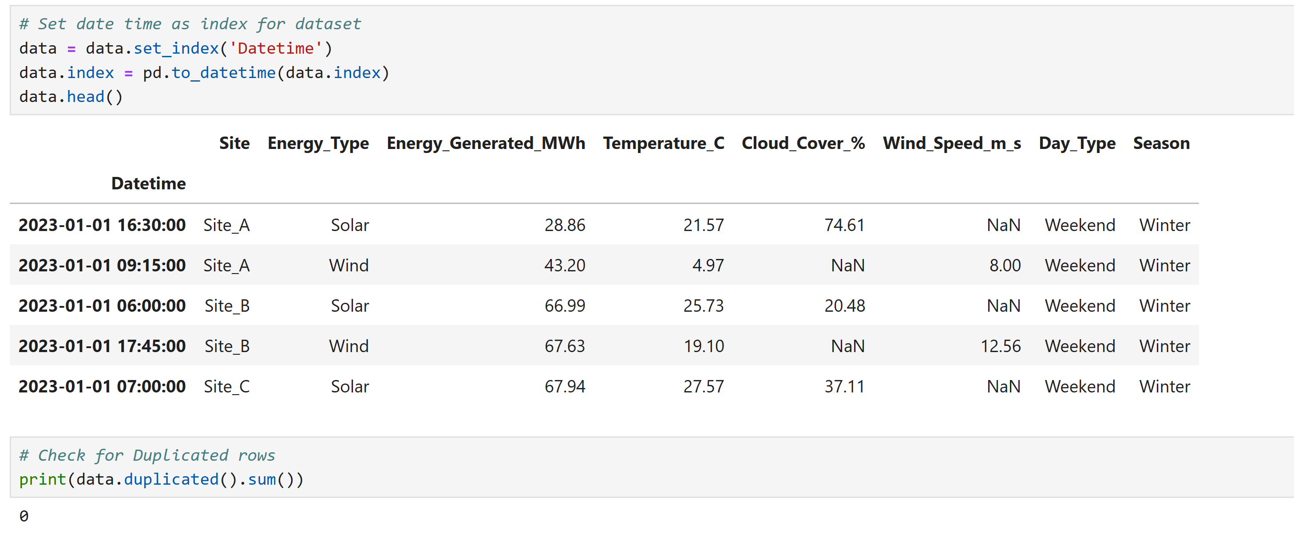
Align timestamps
Converted Datetime from object to datetime format and set it as index
There are no duplicates

Slide 8
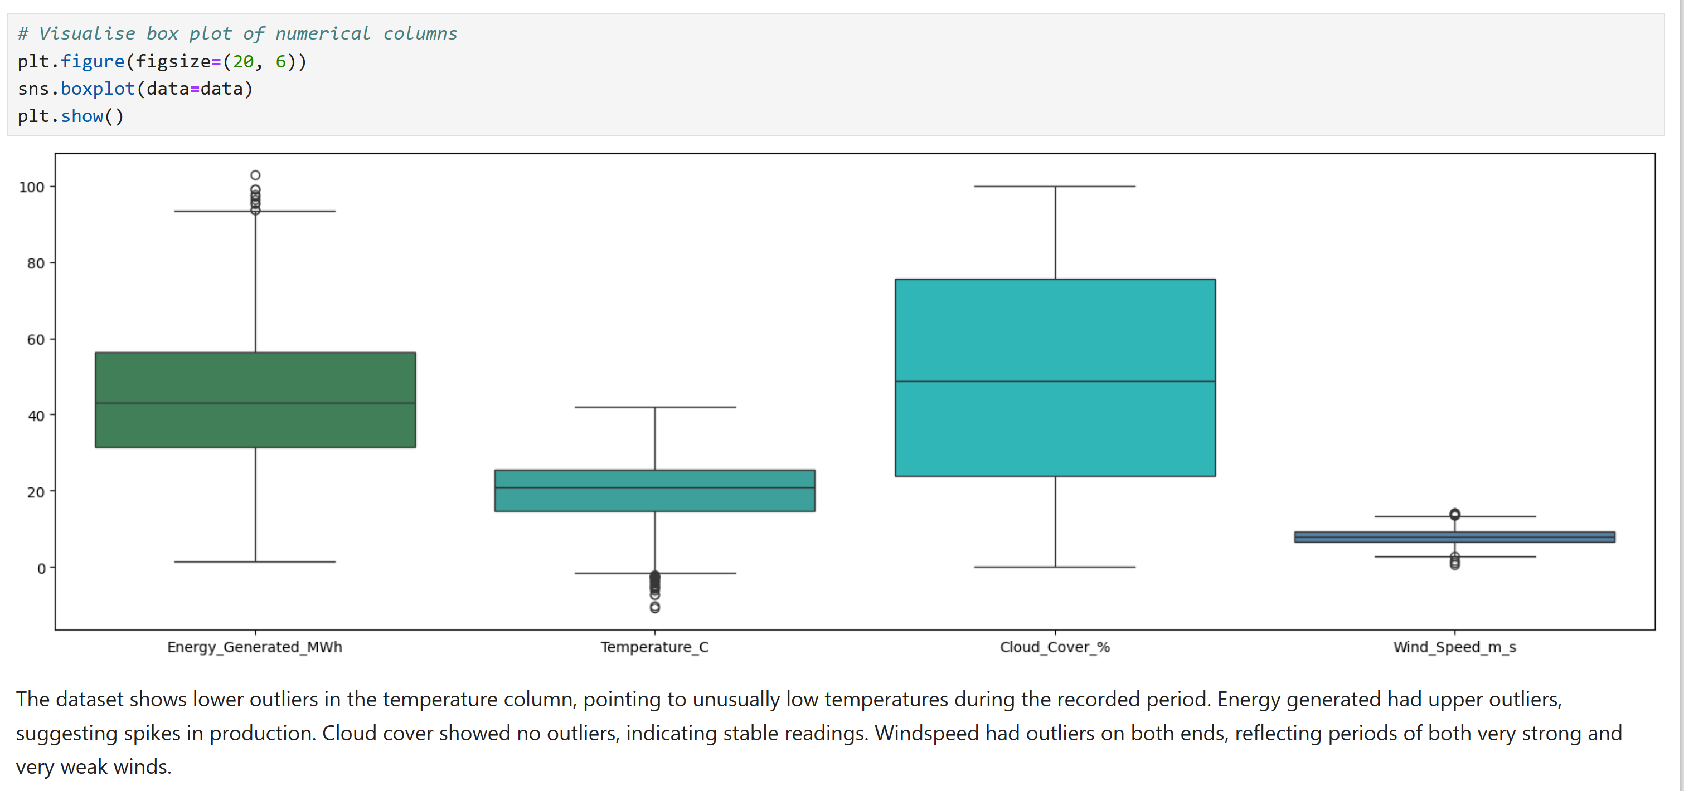
4 Exploratory Data Analysis (EDA)
Checking Outliers in Numerical Columns

Slide 9
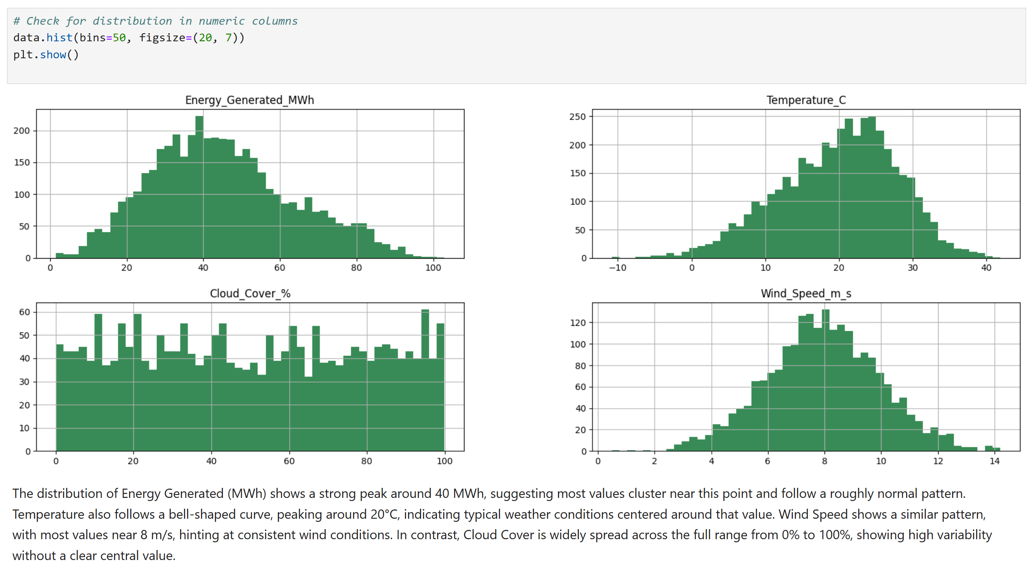
Exploratory Data Analysis (EDA) cont’d…
Checking Outliers Categorical Columns

Slide 10
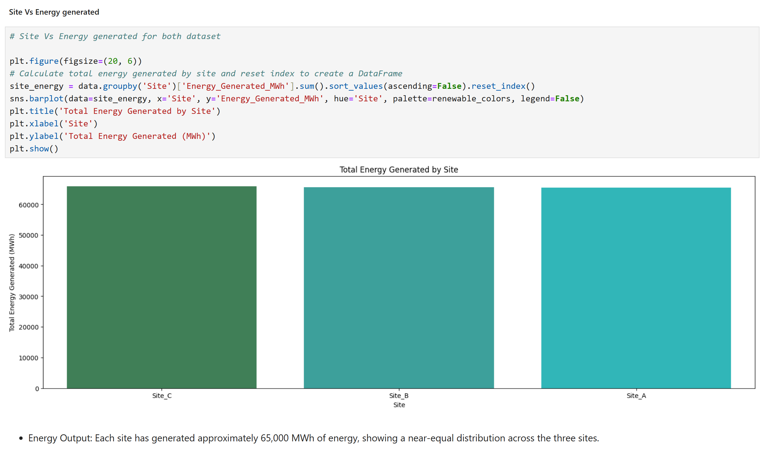
Exploratory Data Analysis (EDA) cont’d…
Bivariate Analysis

Slide 11
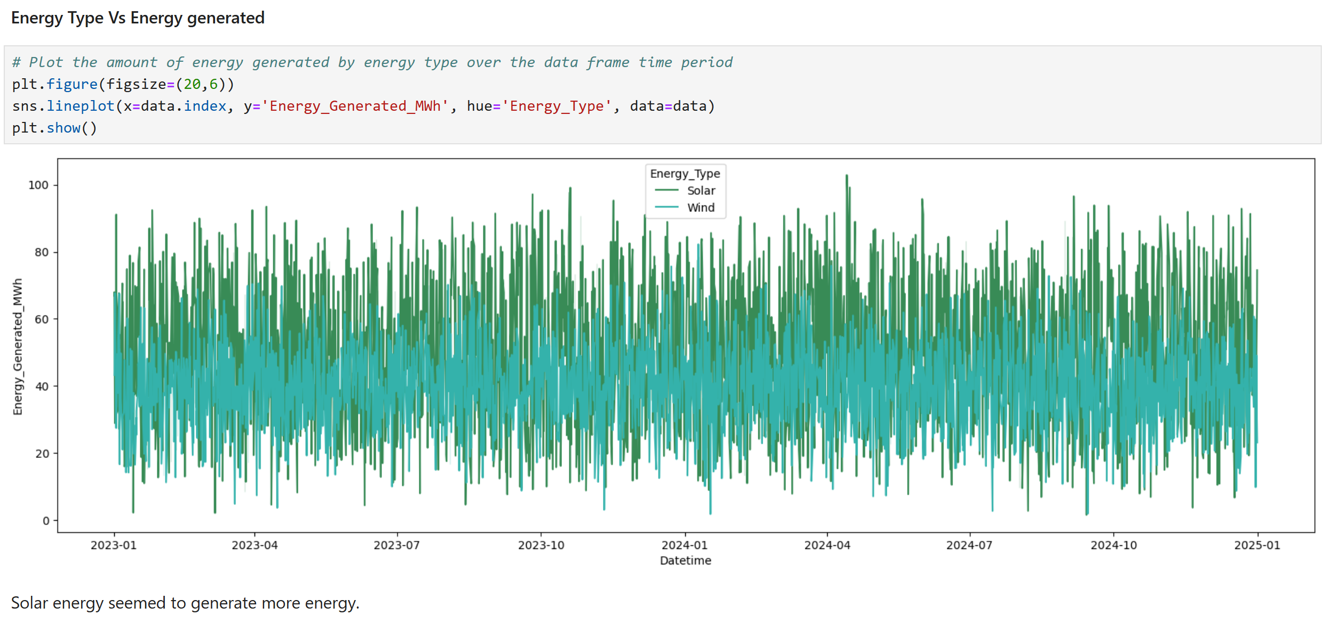
Exploratory Data Analysis (EDA) cont’d…
Bivariate Analysis

Slide 12
Exploratory Data Analysis (EDA) cont’d…
Checking Outliers Categorical Columns

Slide 13
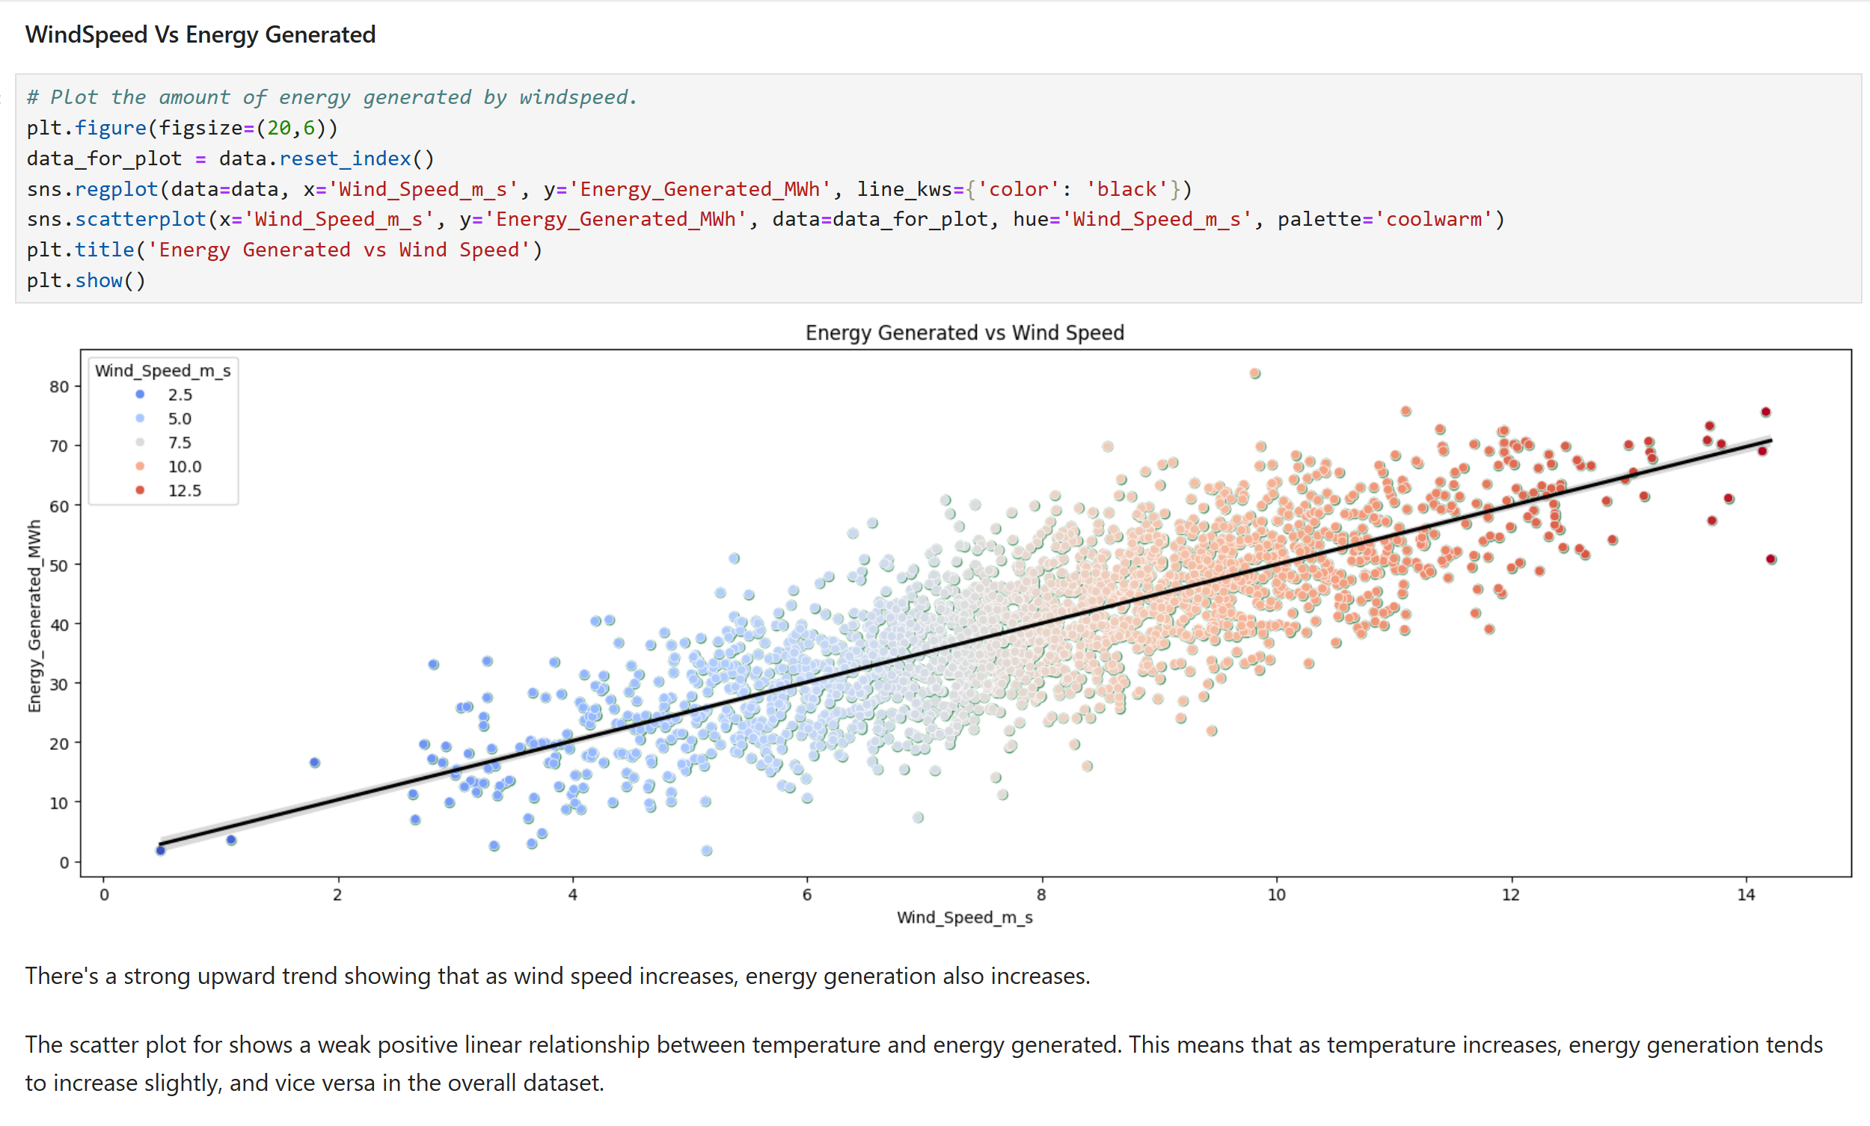
Exploratory Data Analysis (EDA) cont’d…
Windspeed vs Energry Generated

Slide 14
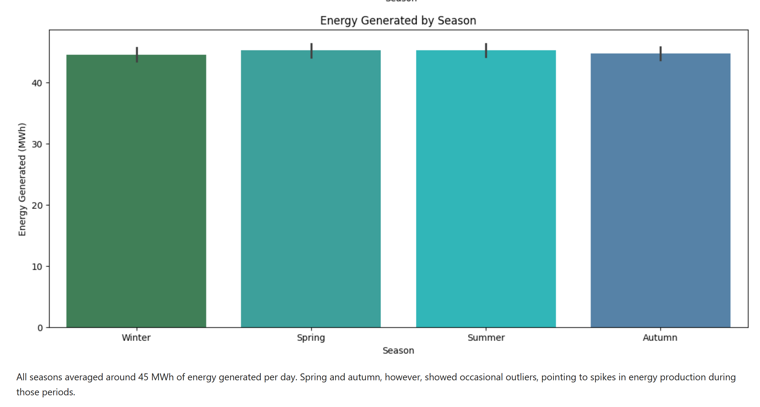
Exploratory Data Analysis (EDA) cont’d…
Energry Generated by Season

Slide 15
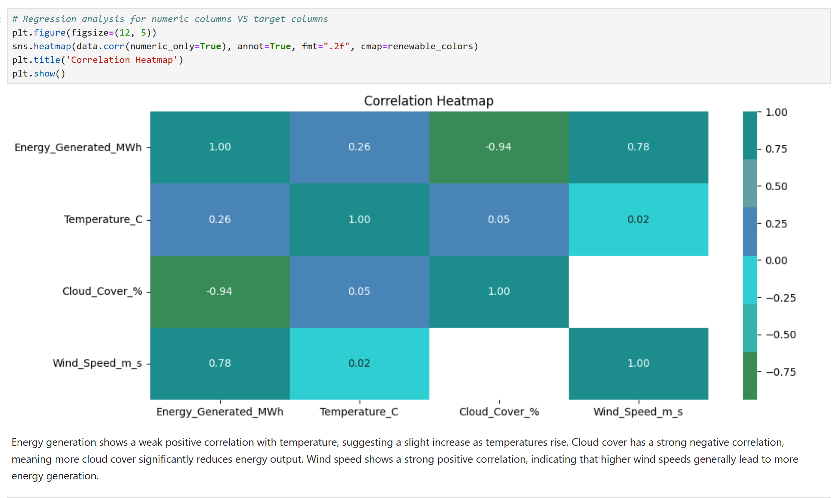
Exploratory Data Analysis (EDA) cont’d…
Multivariate Analysis

Slide 16
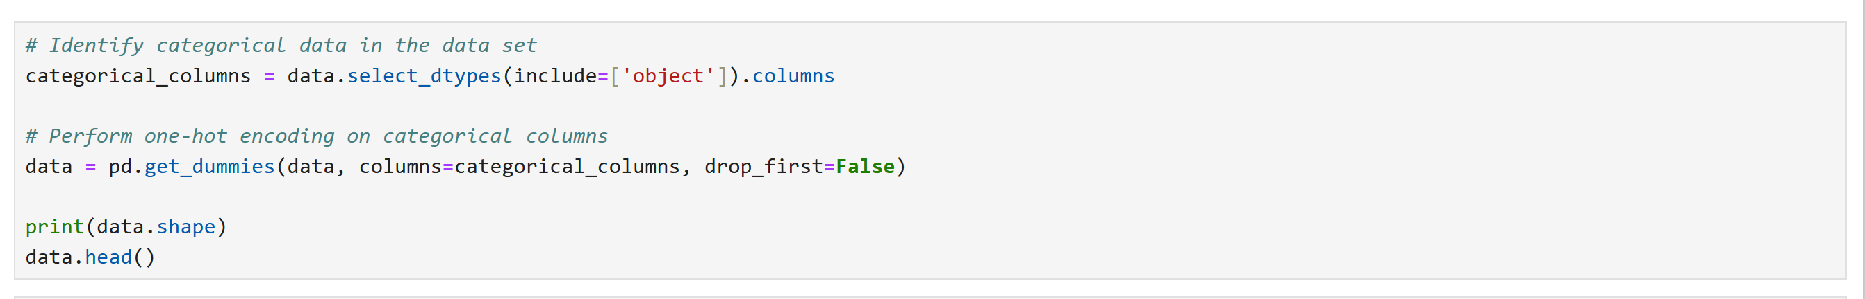
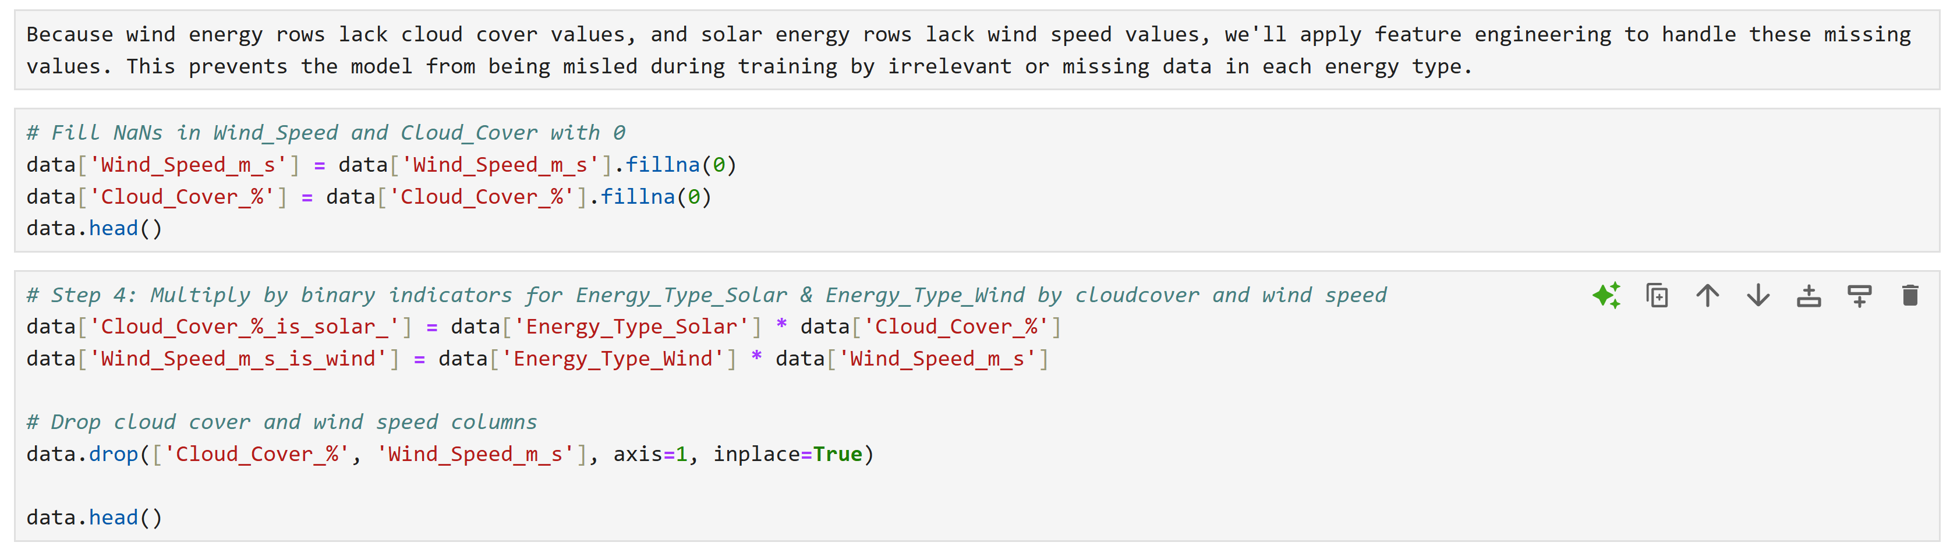
5. Feature Engineering
Encoding categorical features (e.g., season, day type)
Filling missing spaces

Slide 17
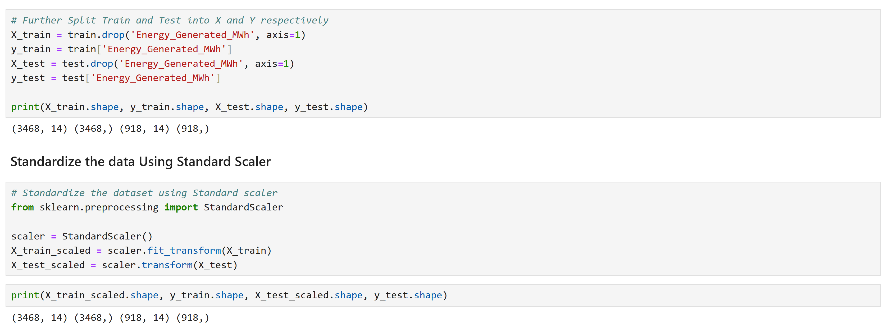
5. Feature Engineering
Splitting dataset into Test and Train sets
Standardized using StandardScaler

Slide 18
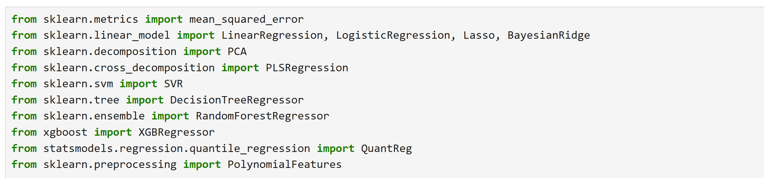
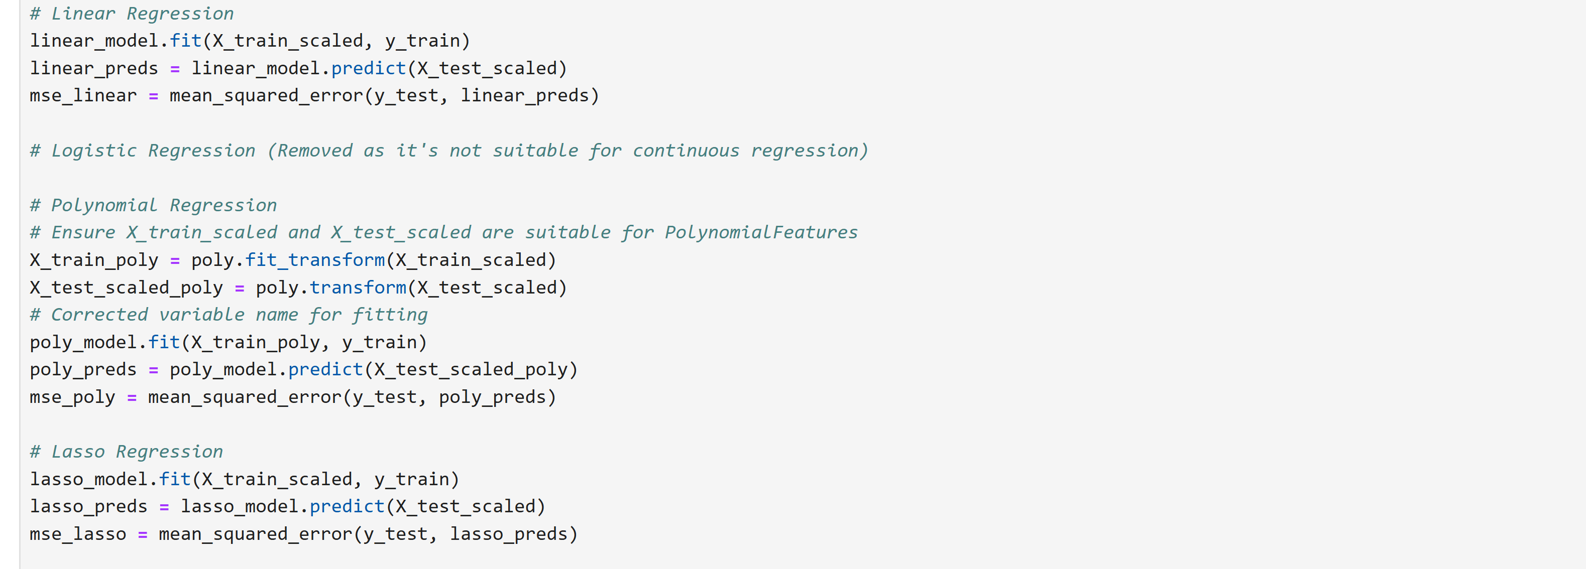
6. Model Development & Forecasting
Importing Machine Learning Models
Fitting dataset into Regression model
Fitting dataset into Polynomial Regression model

Slide 19
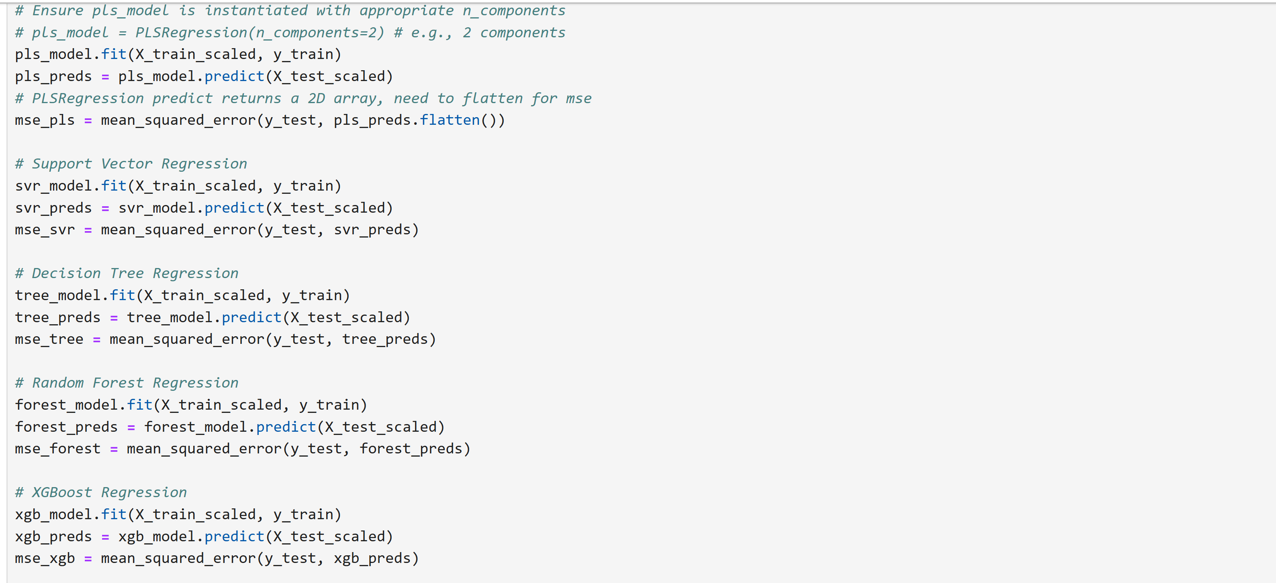
6. Model Development & Forecasting
Fitting dataset into Partial Least Square Regression model
Fitting dataset into Support Vector Regression model
Fitting dataset into Decision Tree Regression model
Fitting dataset into Random Forest Regression model

Slide 20
6. Model Development & Forecasting
After training and testing ten different regression models, the Polynomial Regression model achieved the lowest MSE (46.34), indicating the best performance in capturing the underlying patterns of the dataset.
Model | MSE
Polynomial Regression | 46.34
Random Forest Regression | 53.13
Linear Regression | 55.26
Principal Components Regression | 55.26
Bayesian Ridge Regression | 55.27
XGBoost Regression | 56.59
Support Vector Regression | 82.18
Decision Tree Regression | 88.41
Lasso Regression | 101.40
Partial Least Squares | 122.81

Slide 21
6. Model Development & Forecasting
Analysis:
Polynomial Regression achieves the lowest MSE (46.34), indicating it best captures the underlying non-linear patterns in the energy generation data.
Random Forest (53.13) and Linear Regression (55.26) also perform relatively well, but fall short of Polynomial Regression’s precision.
Partial Least Squares Regression shows the highest MSE (122.81), suggesting poor model fit and limited predictive power for this use case.
Lasso Regression and Decision Tree Regression also show higher error rates, indicating less reliability.

Slide 22
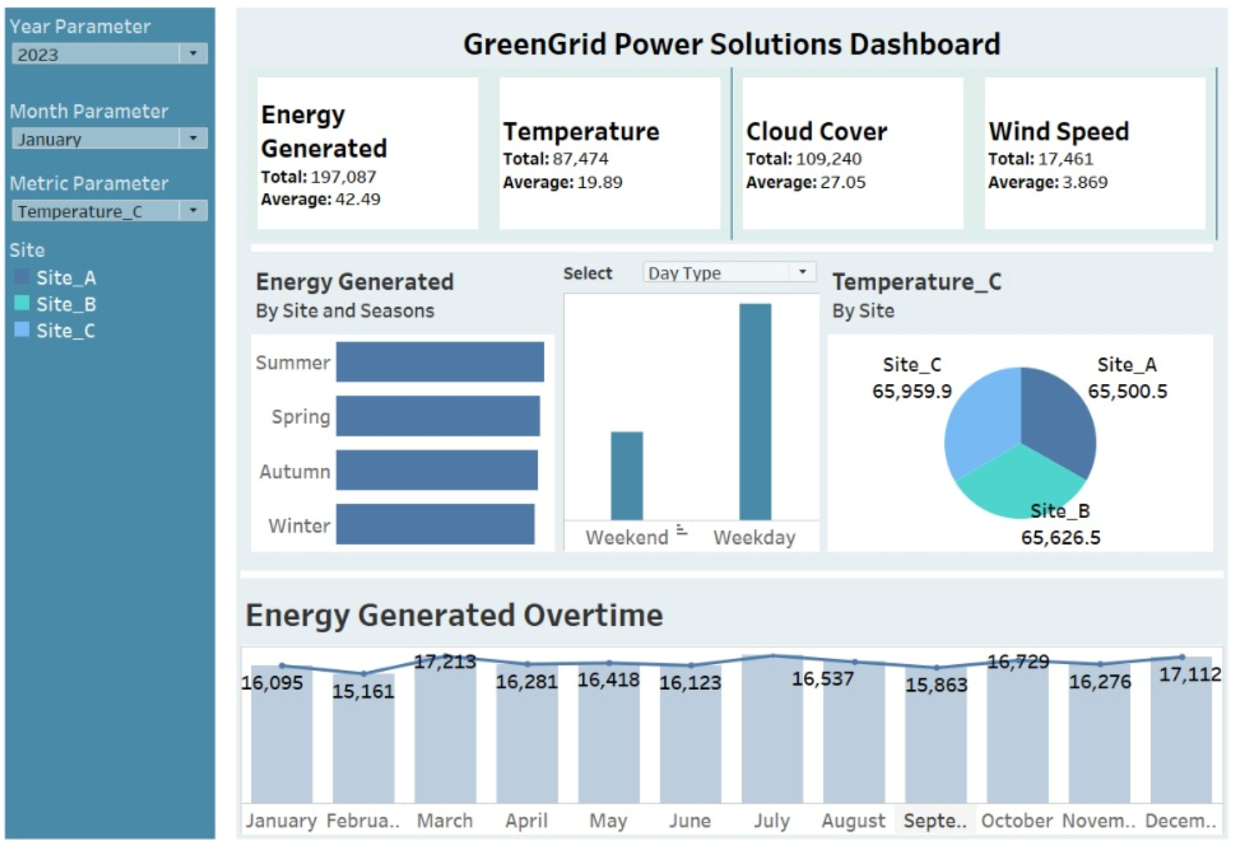
7. Dashboard Development
Design a Tableau dashboard toVisualize historical and forecasted energy trends. Include filters (by site, season, energy type). Highlight KPIs and capacity utilization.

Slide 23
8. Recommendations
We recommend deploying the Polynomial Regression model for production use in predicting renewable energy output, due to the following reasons:
Best Accuracy: Lowest MSE among all tested models.
Non-Linear Capability: Effectively captures complex relationships in the data.
Proven Advantage: Outperforms linear and ensemble methods in this context.
However, care should be taken to:
Monitor for Overfitting: Validate the model using cross-validation or test on unseen future data.
Adjust Degree Appropriately: Avoid high-degree polynomials that may overfit noise.

